Slide 1
ISMS Awareness Training (Test V1.6)
SQA
Submitted to
L&D
Jasmin Infotech Private Limited
August 2025

Slide 2
Topics
Asset
Information Classification
Risks and Threats of Assets in an Organization
Pillar of ISMS
User Responsibility Asset Usage
User Responsibility Email Usage Policy
Access control
Asset management
Mobile Device
Password
Equipment Management
Incident Management
BCP
NDA
Best Practices

Slide 3
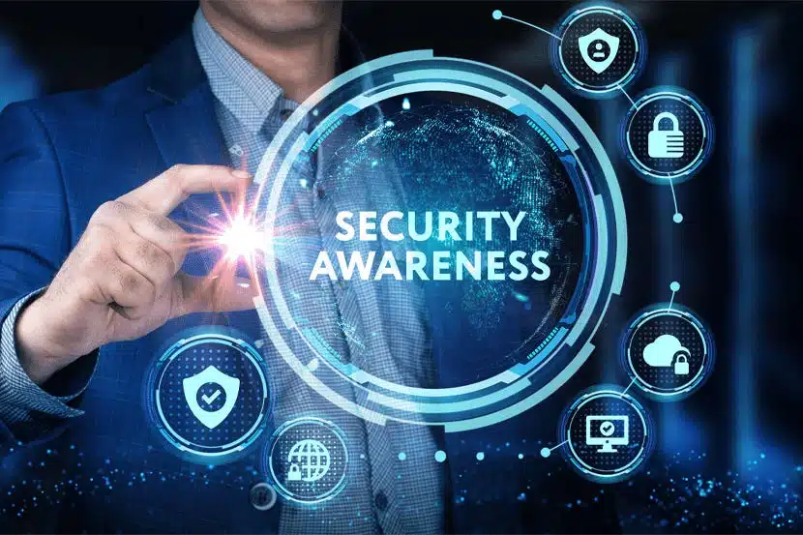
Awareness Training
July 2025

Slide 4
Assets
Anything that adds value to the organization is asset
Information
Intangible
People
Services
Hardware
Software
Physical Office

Slide 5
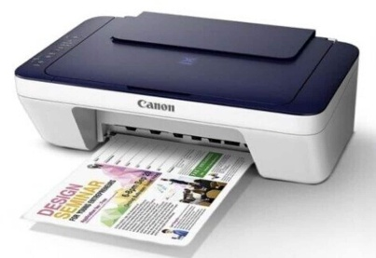





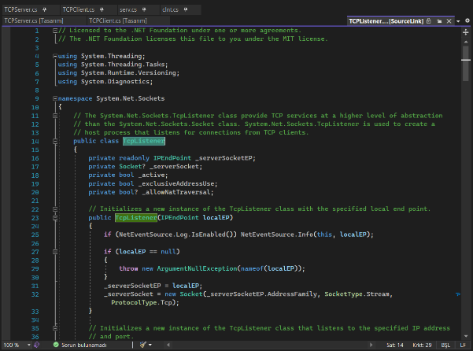
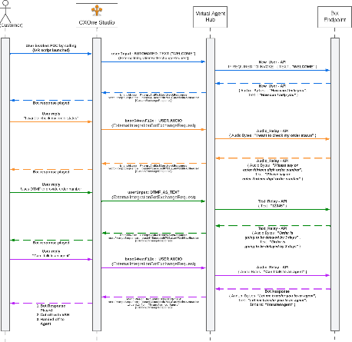


Information
Printouts
Handwritten notes
Document files
conversations
Video recordings
Source codes
Designs
e-mail
Any work product
Information has value, and should be protected when it is shared, stored or transmitted

Slide 6
Information Classification
Level / Name | Description | Instances
A+ Strictly Confidential / Restricted Access | * That is restricted to only identified members. * Not to be shared even internally. * Identified members alone should have access (BD, Finance, Customer Specific, HR, etc.) * Information shared by the customer or customer specific information that is handled by JI which shall not be used or shared outside the purview of the project or engagement | Commercial Data. Contracts/Agreements. Personal data of employees. Customer Proprietary information. Data / information controlled or handled inside the earmarked zone.
A Confidential / Access Controlled | * Information that is restricted to identified members. * Information pertaining to a group of projects, either shared by customer to JI or information generated and used by JI that are restricted to either business line / technology / domain / group, etc. Such information shall not be available outside the identified scope. * Licenses purchased by JI would forms part of Level ‘A’ and only IT is authorized for license management. | Project related Software / Hardware, applications, etc,. Shared files / content from and to customer from the project. Function wise data / documents. Test streams for multiple projects.
B Internal Use | * Information that is readily available for all JI users. * All information or assets that are accessible to employees of JI and shall not be accessible to outside of the JI | QMS documents / Training materials. Tools for JI internal operations. Signal Generator / RPS, etc,. Internal Newsletters.
C Public Use | Information that can be shared without any access restrictions | JI Website data.

Slide 7
Risks and Threats for Assets in an Organization
Organizational
Physical
No security at the entrance
Lack of monitoring
Clear desk and clear screen issue
Network connectivity issue
Lack of cable protection
Lack of disposal process of unused assets
Lack of policy & procedures
Unclear roles & responsibilities
Sensitive/critical assets unattended
Admin access to unauthorized person
Deletion/modification of records
People
Technological
Phishing Attack/Cyber Attack
Email threat
Virus Attack
Theft of Source Code
Lack of Backup – Data loss
Lack of Web filtering
Poor recruitment process
Skipping of background verification
Lack of HR policies
Lack of disciplinary process implementation
Not following remote working policy

Slide 8


Information Security and It’s Responsibility
The responsibility of Information Security
is not just Top Management
is not just IT team
is not just HR team
is not just Admin team……
It is everyone’s responsibility

Slide 9
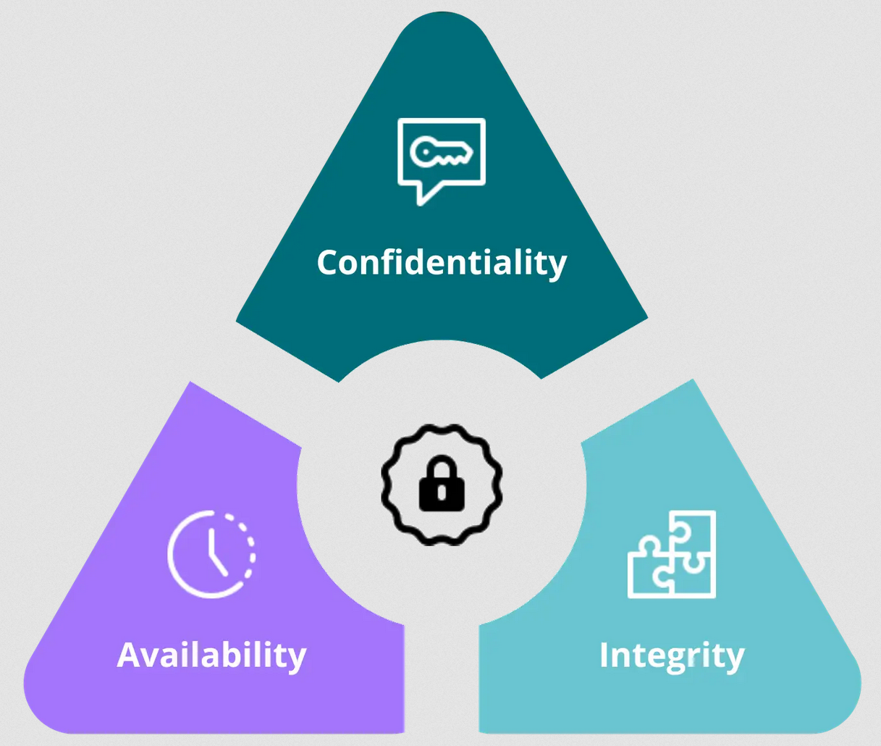
Pillars of ISMS
Accuracy and completeness
Accessible to authorized person
Information security
Assets
Not disclosing to unauthorized person

Slide 10
Information Security
Preservation of Confidentiality, Integrity and availability of the assets in the organization is Information security

Slide 11


User Responsibility Email Usage Policy
Use Official Email for BUSINESS purpose only
If you come across any Junk/spam/suspicious Email do the following
Always check the domain of the Email.
Correct -@jasmin-infotech.com
Incorrect -@jasmien-infotech.com
Remove the Email
Inform the same to IT Team
Check before clicking on anonymous links.
Do not send Emails to client unless you are authorized to do so
Do not reply or forward suspicious email
Do not open the Email or attachment which is suspected to be virus or received from an unidentified sender.
Sending Emails to public domains like gmail, yahoo, etc., are blocked. Exceptions are provided after approval. If you are given approval, use it prudently.

Slide 12



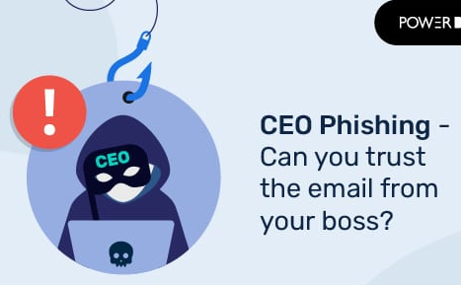


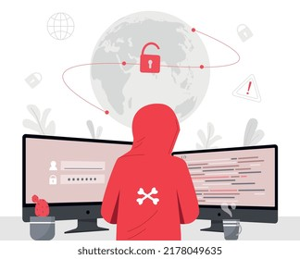
Phishing Email
How to identify Phishing Email?
IF IN DOUBT SEEK ASSISTANCE FROM IT.
DO NOT PROCEED UNTIL YOU ARE CLEAR
Don’t click on any suspicious / anonymous links.
Check before you access any links
NEVER enter any credentials in non-official pages.
Check the sender address and domain name of the mail.
Threatening
Email

Slide 13
Access control
DO NOT Tailgate.
Do not bring visitors in operations area without prior permission
Do not use public networks for business purpose as they are vulnerable.
Social media like Facebook, LinkedIn, Twitter etc., are blocked.
Do not share official / customer information or names on your social media.
Wear ID Cards all the time inside the premises. Attend visitors at the Reception.
Request for access to the organizational network and systems must be submitted to IT.
Managers are to report Admin to revoke access on reallocation to identified zones.

Slide 14
User Responsibility Asset Usage and Handling
Gate pass need to be updated when assets are taken outside and returned to Jasmin.
Use only authorized removable media for a particular duration.
Maintain the physical asset in a closed cabinet when it is not in use.
Ensure to log, track and keep updated asset status in inventory tracking tool (redmine).
Leave confidential assets unattended while in office / travel.
Exporting software, technical information, Use encryption software or technology. It is illegal.
Attempt to copy / access copyrighted material.
Take assets outside the premises without authorization.

Slide 15
Asset Value and frequency of review
Level | Confidentiality | Integrity | Availability | Inventory Reviews
A+ | 3 | 3 | 3 | Review → Monthly
A | 2 | 2 | 2 | Review → Monthly
B | 2 | 2 | 2 | Review → 3 months
C | 1 | 1 | 1 | Review → 3 months
Level | Confidentiality | Integrity | Availability | Inventory Audits
A+ | 3 | 3 | 3 | Audit → 3 months
A | 2 | 2 | 2 | Audit → 3 months
B | 2 | 2 | 2 | Audit → 6 months
C | 1 | 1 | 1 | Audit →12 months

Slide 16
Mobile Device
All the mobiles used for business activities must be registered with IT Team.
Authorized Mobile devices used need to be protected with controls
Mobile devices should be stored in a safe place to avoid theft
Do not take photos inside the restricted zones. Zone definitions can be referred from ISMS3022 Phyiscal_Secuirty_and_Control_Policy JIAS
Do not bring any personal mobile devices such as iPods, USB Sticks, Laptops.
Do not connect your mobile phone to the office network

Slide 17
Password
Do not use passwords which reveals your personal information or easy words
User ID: xxx@gmail.com(Personal Email) Personal password: meGhA_2001
User ID: abc@jasmin-infotech.com (Official Email) Official password: Jan@2025
Do not write down or Store password
Do not share password over phone or Email
Use similar passwords between personal and official accounts.
Always use at least 8-character password with combination of alphabets, numbers and special Character (*, %, @, #, $, ^)
Use of password that can be easily remembered by you
Change password regularly as per policy
Use password that is significantly different from earlier passwords

Slide 18
Equipment Management
Computer workstations must be locked when workspace is unoccupied​​
Whiteboards containing any information should be erased in conference hall​​
File cabinets containing Restricted or Sensitive information must be kept closed and locked when not in use or when not attended​​
Upon disposal all the documents should be shredded in the official shredder by the HR team.​
Do not leave printouts containing any information in the printer.
Do not leave any equipment’s without labelling / identification.

Slide 19
Procedure to take Work Terminal Outside Organization
Do not Leave organization assets unattended while travelling.
Do not share assets without approval even with JI members. You are still obligated with its safe use and care.
Be aware of your surroundings while you are working in public places.
Sign in the ISMS1502 Workterminal Takeout requisition form JIAS with approval from reporting in-charge.
Get Gate pass from security. Ensure to keep the gate pass safely.
Ensure to return the gate pass while returning the asset.

Slide 20
A+ Zone
Share the sensitive information you have access to other team member
Lookup confidential information for co-workers who do not have access without PM approval
Store confidential files on unidentified location.
Throw confidential reports in the trash without shredding them first
Share files with authorized personnel
Obtain permission for secondary use of data(uses other than originally approved)
Remove all confidential or sensitive data from your workstation before it leaves your control.
Always ensure that doors, gates, or access points are securely closed and locked when not in use.

Slide 21
Incidents
Incident is a violation that occurred against confidentiality, Integrity and Availability
Critical/ Sensitive asset unattended
Data/asset lost during Remote Working
Someone is connecting mobile phone to office network
Abnormal browser behaviour
Loss of data in the server
Unknown person in the office without a visitor tag
Someone is taking video in the office
Access machine at the main door is not working
Server room is kept open unattended
CCTV Camera is broken
A virus notification in your computer
Someone has brought his/her personal laptop to office
Unable to connect to the office network for more than 30 minutes
Security guard is not available for 30 minutes
Network / Electricity cable is damaged
An employee is taking away an office asset

Slide 22
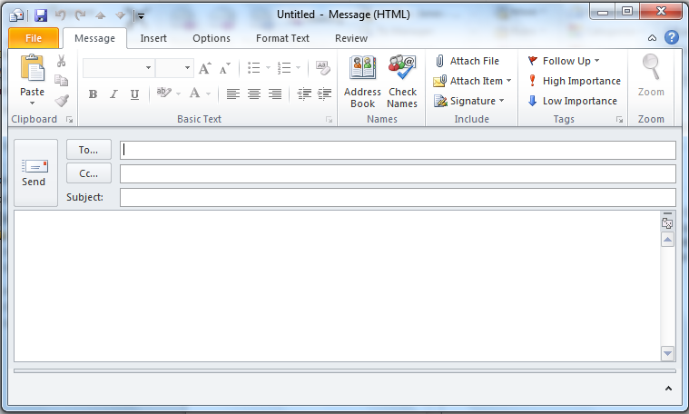
Incident Reporting
Address to the email id given below
Subject line should be “Incident”
Body of the email
Type of incident
Incident Date
Incident location
The person/team involved or affected
Incident description
Project Kickoff
incidencereporting@jasmin-infotech.com
Incidence
Incident Type: Virus Notification
Incident Date: 17/07/2024
Incident Location: Work station No: 56, 5th Floor, DG Square
Person Affected: Mr. XYZ
Incident Description: I received a virus notification in my system.
Final Inspection And Delivery
- Email to incidencereporting@jasmin-infotech.com
Testing

Slide 23
Business Continuity Plan (BCP)
Capability of an organization to continue the delivery of products and services during a disruption.
Cyclone
Fire
Cyber Attack
Internet Connectivity
Flood
Political unrest
Pandemic
Communication is key during the BCP. Top Management => Managers => Leaders => Team members
Wait for the direction from your immediate reporting manager
BCP test will be conducted. Some of you will be chosen for the test.
For Detailed description please refer ISMS_3029_Business_Continity_Policy JIAS

Slide 24
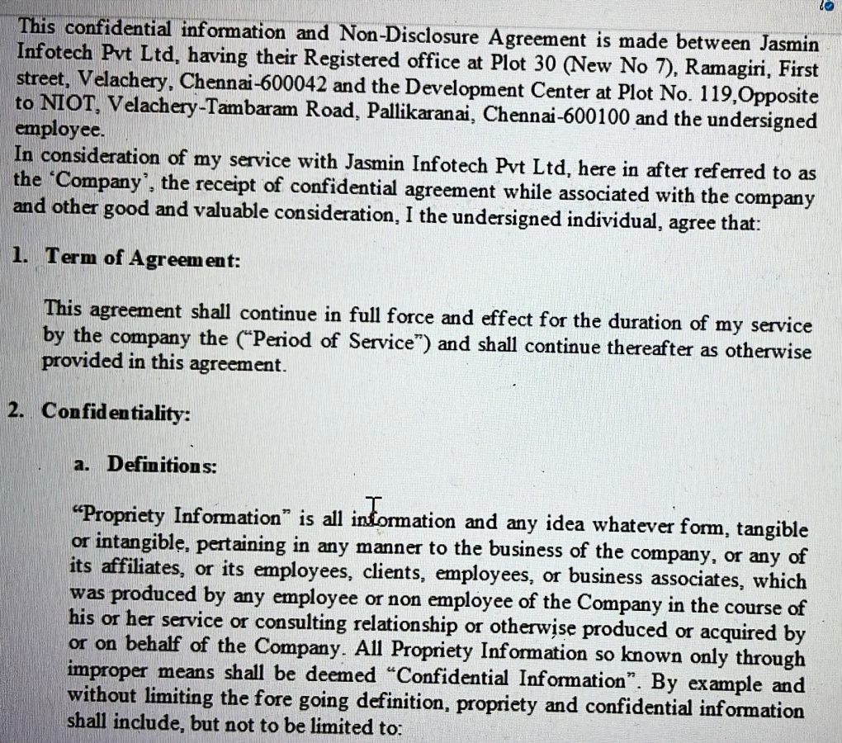

NDA – Non Disclosure Agreement
You have signed
Non Disclosure Agreement

Slide 25
Disciplinary Policy
Level | Definition | Probable disciplinary measures
L1 | Any act that is not in line with the general code of conduct that constitutes good corporate behavior including violation of information security policy or procedure. | Written warning through mail
L2 | Misconducts that has serious consequences but done unintentionally or one of incident or the frequent occurrences of incidents which do not have serious consequences, but does not comply with the expectations of Jasmin or Jasmin policies and/or Failure to take corrective action on level 1 warning and/or information security policy violations or security breach which has less financial loss or potential for Jasmin’s image loss | * Written warning and any or combination of the following * Withholding promotion * Withholding of certificates, monetary dues from company’s side * With holding onsite opportunity
L3 | Serious misconduct wherein the delinquent associate has been found to have compromised with the values of Jasmin / commitment to customers, internal and external / reputation of the company and/or failure to take corrective action on written reprimand and/or serious violations of Jasmin Information policy and procedures, Serious information breaches resulting into financial / reputation loss to Jasmin or posing serious security concerns/ affecting Jasmin’s market image or having major financial / legal implications. | Termination of services by way of dismissal

Slide 26
Best Practices
Project Kickoff
Ensure your system is locked when you are away
Always store Laptops / Media in a lockable place
Be alert while working on Laptops during travel
Ensure sensitive business information is under lock and key when unattended
Ensure back-up of sensitive and critical information assets
Verify the Credential, if the message is received from the unknown sender
Always switch off your computer before leaving for the day
Do not download music, movies, games, etc.
Do not use unlicensed software
Do not share your password to anyone
And last but not least- Report Incidents immediately
Final Inspection And Delivery
Testing

Slide 27

Policy and Guidelines
A policy statement defines a general commitment, direction, or intention, adopted by an Organization Implemented as a procedure or protocol
Procedure is a way of carrying out a process or activity
Guidelines offer recommended approaches or best practices.
Policies, Procedure and Guidelines are located at JIAS
ISMS_3001_Access_Control_Policy.
ISMS_3002_Vulnerability_Control_and_Protection_Policy
ISMS_3003_Asset_Managemen_Policy.
ISMS_3004_Equipment_Management_Policy.
ISMS_3005_Communication_ and_ Operational_ Management Policy.
ISMS_3006_Cryptography_Control_Policy.
ISMS_3007_Data_Backup_and_Restoration_Policy.
ISMS_3008_Disciplinary_Policy.
ISMS_3009_Information_Management_Policy.
ISMS_3011_HR_Policy.
ISMS_3012_Incident_Management_Policy.
ISMS_3013_Information_Security_in_Project_Management.
ISMS_3014_Information_Security_Policy.
ISMS_3016_Internal_Policies_List.
ISMS_3017_Legal_Statutory_and_Regulatory_Complaince_Policy.
ISMS_3019_Endpoint_Devices_Policy.
ISMS_3020_Authentication_ Information_Control_Policy.
ISMS_3022_Physical_Security_and_Control_Policy
ISMS_3023_Privacy_and_Protection_of_Personally_Identifiable_information

Slide 28
Policy and Guidelines
Policy list contd.
ISMS_3024_Configuration_Management_Policy
ISMS_3025_Network_Server_Security_Policy.
ISMS_3026_Software_Installation_Policy.
ISMS_3027_Security_in_Supplier_Relationships_Policy
ISMS_3028_Teleworking_Policy.
ISMS_3029_Business_continuity_policy
ISMS_3030_Capacity_Management_Policy
ISMS_3031_Change_and_Test_Management_Policy ISMS_1019_Information_Control_Aplus
ISMS_3032_Logging_and_Montioring_Policy
Guidelines
ISMS_1013_TG_Information_Asset_Classification_Guidelines
ISMS_1014_TG_HR_Code_of_Conduct_Guideline
ISMS_1015_TG_HR_Information_Security_Guidelines
ISMS_1020__TG_Acceptable_use_of_assets_Guidelines
Procedure
ISMS_1012_Risk_Assessment_and_Risk_Treatment_Procedure

Slide 29
Roles and Responsibility
Organization Roles and Responsibility of various functions can be referred from JIAS
ISM – Information Security Manager | 1. Develop policies, procedures, and standards to ensure security, confidentiality and privacy of information that is consistent with organizational Information security policy. 2. Planning and Execution of the ISMS Audit in the Organization. 3. Coordinating in analyzing the incidence and implementing the corrective action for the incidence. 4. Defining and implementing appropriate safeguards to ensure the Confidentiality, Integrity, and Availability of the information asset. 5. Responsible for review and approval of Risk Management process. 6. Ensure that the security aspects and day-to-day security operations of the information system. 7. Collaborating with other teams (IT, HR, Admin, etc.) to improve overall security posture. Communicating security issues and strategies to senior management and stakeholders. 8. Collaborating with stakeholders across the organization to develop comprehensive Business Continuity Plans (BCPs) and (DRP) Disaster Management and Recovery Plan that address IT infra, General, physical infra. 9. Assessing and monitoring the ISMS compliance in the organization. 10. Status reporting of the ISMS Non - Compliance to the Senior Management.
Coordinator Business continuity (CBC) | 1. CBC (Coordinator Business Continuity) would be assigned and be responsible for handling the BCP on cases of the disaster. The CBC would report to the Steering Committee 2. Periodically reviewing the adequacy and appropriateness of its Business Continuity strategy. 3. Assessing the impact on the Business Continuity Plan by modifying the existing business functions, procedures, equipment, and facilities requirements. 4. Keeping recovery team personnel assignments current, considering promotions, transfers, and terminations. 5. Act as single point of contact for business functions and oversee BCP operations. 6. Responsible for grading the contingency (G, Y, O, R).
Steering Committee | 1.Interpreting the business and information needs to the organization and translating them in to ISMS initiatives 2.Setting Strategic direction for the ISMS Management based on the Inputs from the Executive committee 3.Ensuring that ISMS Management Investment is aligned to the Strategic goals of the Organization 4.Ensuring the Project and Initiatives are aligned and coordinate to deliver the Right Values 5.Ensuring the ISMS Planning is integrated into the business planning 6.Responsible for incidence handling and management 7. Providing oversight and guidance on identification, assessment, and mitigation of information security risks across JI. 8. Monitoring effectiveness of the ISMS through regular performance reviews, metrics, and KPIs related to information security.
Executive Committee | 1. Set overall strategic direction and boundaries of the ISMS, defining clear objectives, policies, management frameworks to information security practices across the organization and delegate operational responsibilities to the respective members. 2. Approve and oversee the development, review, and update of information security policies, standards, and guidelines. 3.Oversee the organization's incident response and business continuity plan.

